Slide 1



Open Education Analytics

Slide 2

Real Time State and National Reporting
KEY DATA AND AI USE CASES NEEDED IN EDU
Digital Learning Insights and Research
Program and Investment Evaluation
Predicting At Risk and Successful Students
Verified Credentials and Learner Records
Personalized Learning Pathways
Notes:
We see Open Edu Analytics as a natural next step in customers’ journey to Learning Analytics and AI. And we have many large education system customers who are interested in taking this journey, including state departments of education and national ministries of education around the world.
The great news for partners is that there are many opportunities to participate in this ecosystem, and we are depending upon you to make it scale and grow the assets.
Starting from the thousands of customers adopting SDS and Education Insights, there are many steps in the journey where ISVs, System Integrators, data science and AI companies, and Training providers will be needed to build this Open Education Analytics ecosystem.

Slide 3

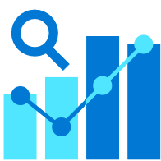
Datasets are dispersed and poorly governed
EDUCATION’S CHALLENGES WITH DATA AND AI
Concerns over data privacy and ethical use of AI
Low organizational expertise in learning analytics and AI
Getting started is overwhelming
Notes:
We see Open Edu Analytics as a natural next step in customers’ journey to Learning Analytics and AI. And we have many large education system customers who are interested in taking this journey, including state departments of education and national ministries of education around the world.
The great news for partners is that there are many opportunities to participate in this ecosystem, and we are depending upon you to make it scale and grow the assets.
Starting from the thousands of customers adopting SDS and Education Insights, there are many steps in the journey where ISVs, System Integrators, data science and AI companies, and Training providers will be needed to build this Open Education Analytics ecosystem.

Slide 4



What is Open Education Analytics
OPEN-SOURCE TECHNICAL RESOURCES
SKILLS AND TRAINING ON DATA ENGINEERING AND DATA SCIENCE
PRINCIPLES OF RESPONSIBLE DATA AND AI
COMMUNITY OF EDUCATION SYSTEMS DEVELOPING SHARED USE CASES
Notes:
We see Open Edu Analytics as a natural next step in customers’ journey to Learning Analytics and AI. And we have many large education system customers who are interested in taking this journey, including state departments of education and national ministries of education around the world.
The great news for partners is that there are many opportunities to participate in this ecosystem, and we are depending upon you to make it scale and grow the assets.
Starting from the thousands of customers adopting SDS and Education Insights, there are many steps in the journey where ISVs, System Integrators, data science and AI companies, and Training providers will be needed to build this Open Education Analytics ecosystem.

Slide 5
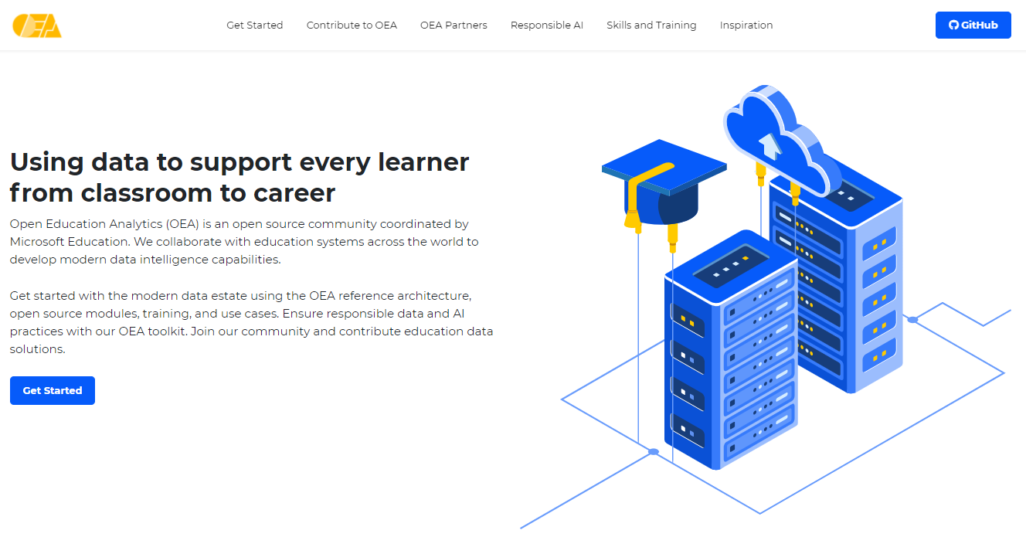
openeducationanalytics.org

Slide 6













Data
Engineers
Data
Scientists
Learners,
Educators
School Leaders,
Researchers
Analysts
Data Sources
Use Cases
Azure Active Directory
Ingest
Prep & Pseudo-nymize
Transform
& Enrich
Optimize
Build
& Train
Explore
Visualize
Package
& Deliver
Student Information Systems
Real Time State or National Reporting
Digital Learning Data
Digital Learning Insights and Research
Azure Synapse
Education Outcome Data
Program and Investment Evaluation
stage 1
(raw data)
stage 2
(data exploration)
stage 3
(model or reporting)
data subsets
SQL serverless
dedicated
SQL pool
Cosmos
Discover & Govern Data
Azure Purview
Notes:
Release notes
Updated OEA framework setup script to simplify installation of framework into existing synapse workspace
New framework assets including linked services, datasets, and pipelines
OEA module creation kit
Microsoft Graph API module - including pipeline, notebook, and power bi report
Contoso hybrid engagement package - including pipeline, notebook, and power bi report
Data generator framework and utilities
Ed-Fi data generator

Slide 7
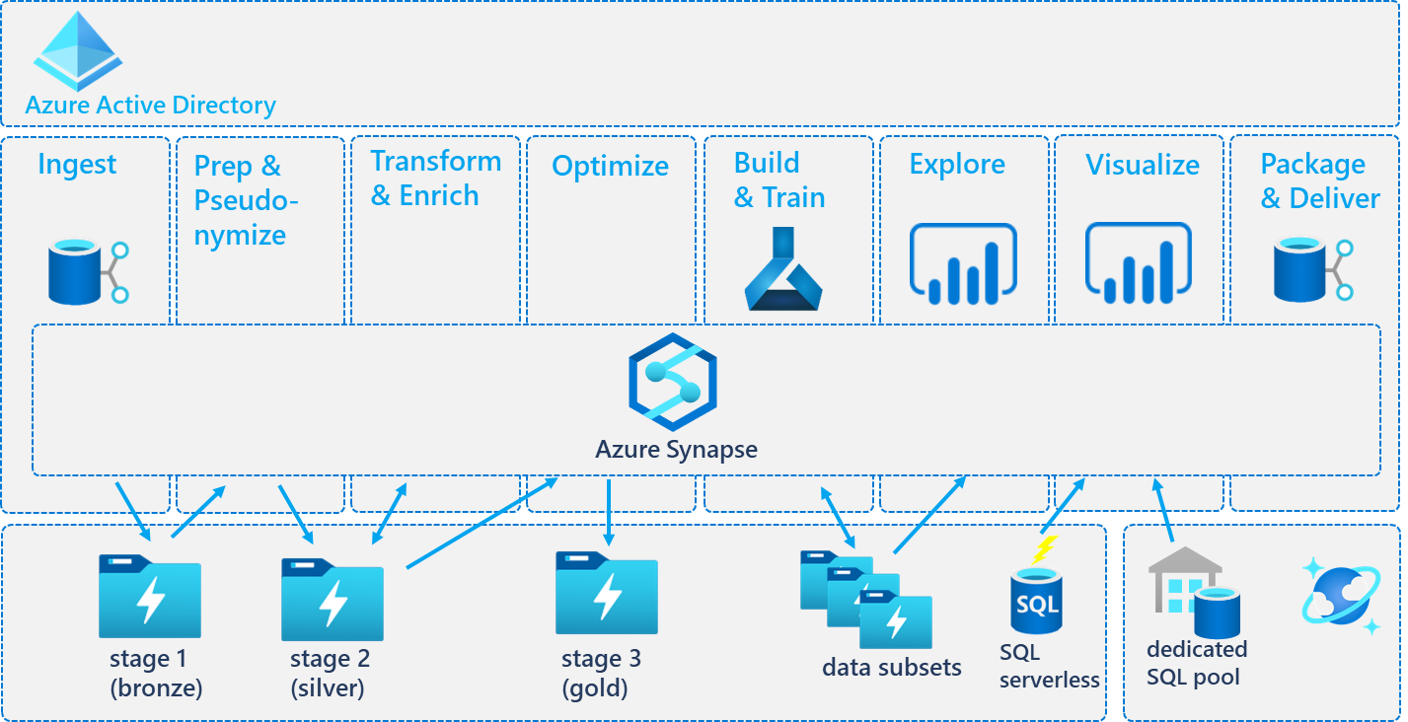
Open-Source Modules for Key Education Data Sources
Open-Source Packages for Common Education Use Cases
Student Information Systems
Real Time State or National Reporting
Digital Learning Data
Digital Learning Insights and Research
Education Outcome Data
Program and Investment Evaluation
Notes:
With Open Education Analytics, we are providing a reference architecture for the Modern Data Estate, and a reference implementation that means you don’t have to build everything yourself. You can:
Provision and govern a modern data estate within your own Azure subscriptions,
Use Synapse studio to facilitate the process of data extraction, ingestion, preparation, transformation, and enrichment
Use Azure Active Directory to enforce role-based-access-control to the data for security and privacy,
Use powerful data visualization tools, such as Power BI, to explore and present data through flexible dashboards
Use modern data science tools, such as Auto ML, that enable high speed research over big data
All built on the foundation of Azure Data Lake storage, which means significant cost efficiencies.

Slide 8
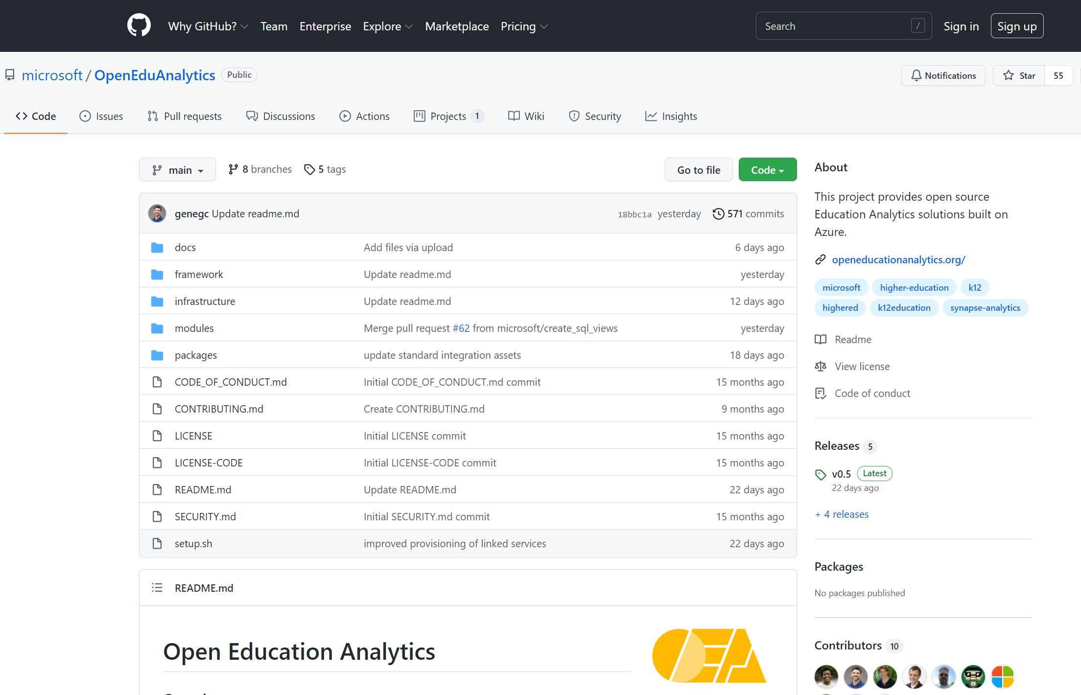
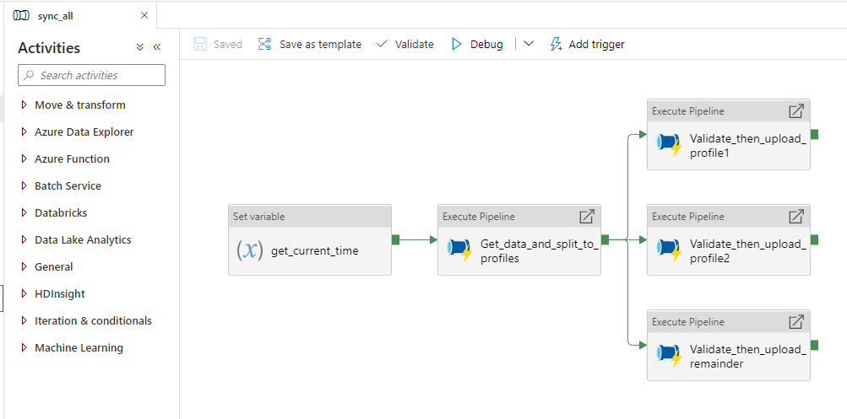
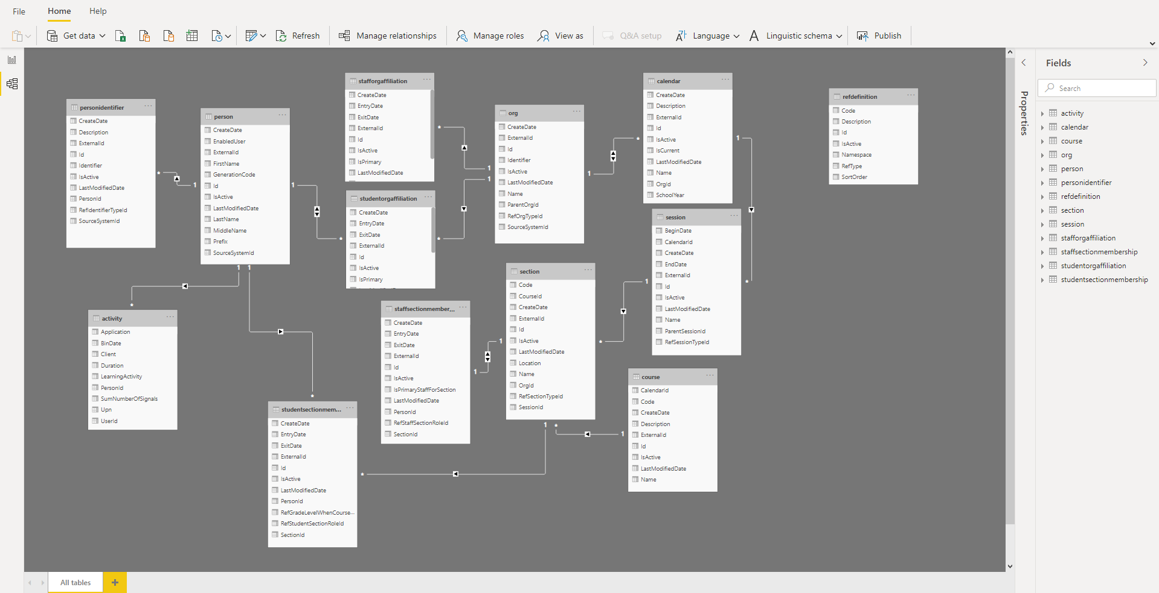
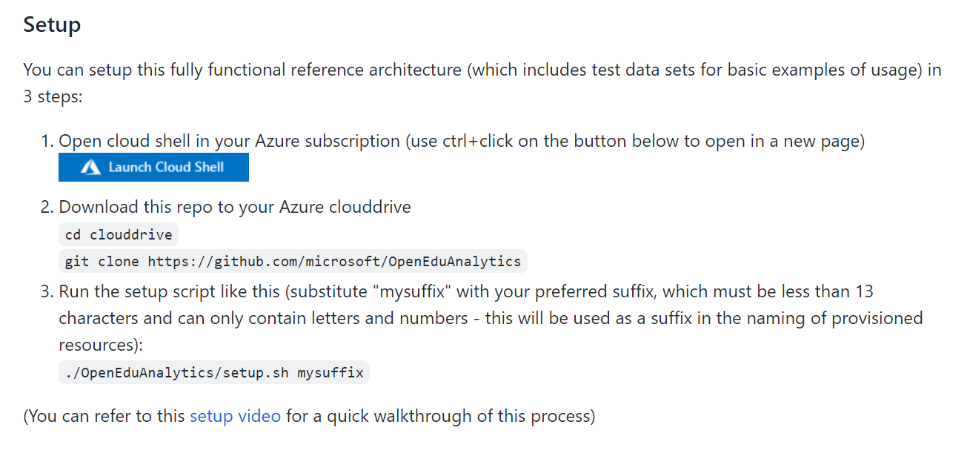
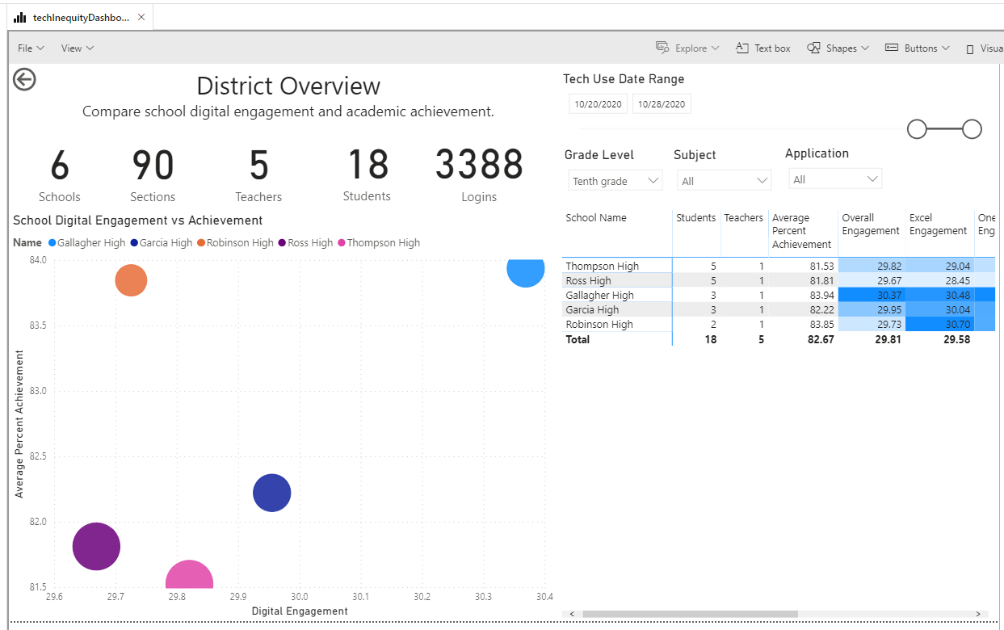
Modules with data pipelines for common edu data sources
Framework and Infrastructure assets for key edu use cases
Reference Architecture Setup Scripts (Azure Synapse)
Packages that combine data for key edu use cases

Slide 9
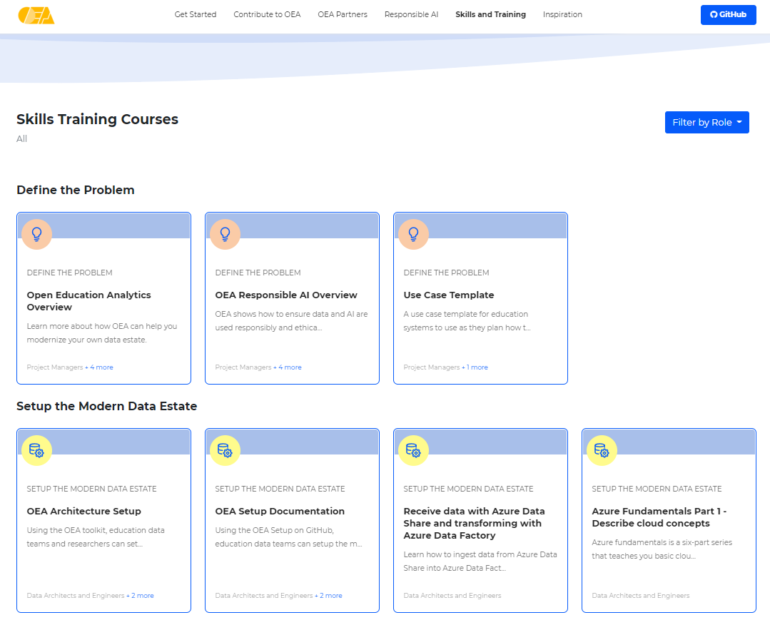
SKILLS AND TRAINING ON DATA ENGINEERING AND DATA SCIENCE
openeducationanalytics.org/skills-and-training/

Slide 10
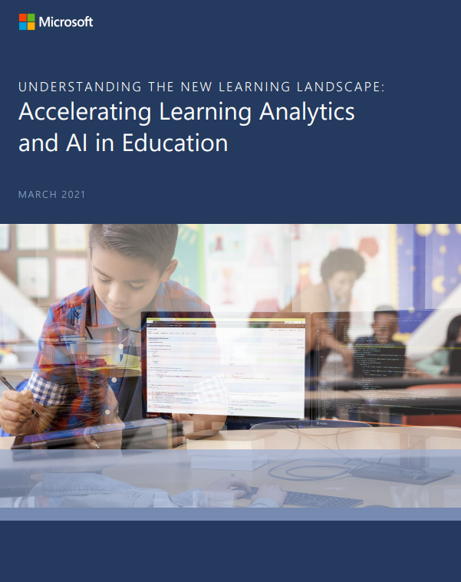
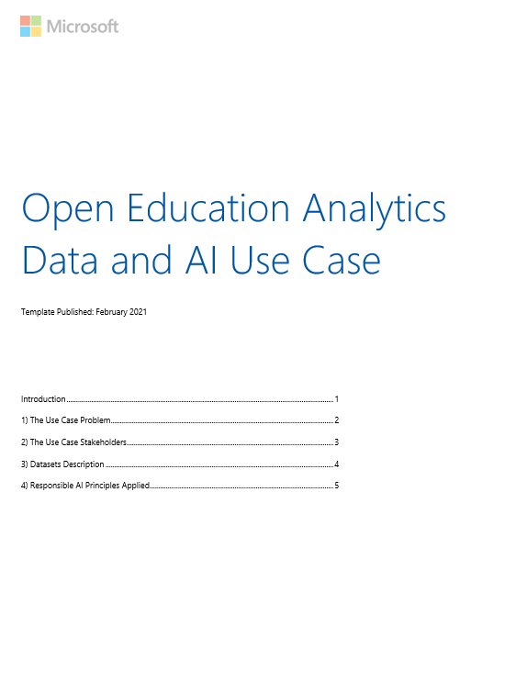
Accelerating Learning Analytics and AI in Education: A report on operationalizing principles of responsible AI in Education |  | OEA Responsible AI Use Case Template
PRINCIPLES OF RESPONSIBLE DATA AND AI

Slide 11
Global OEA Community
Helsinki, Finland
Fresno, California
Azerbaijan
Tasmania DoE
Nebraska DoE
Queensland DoE
New South Wales
Tokyo
Georgia DoE
COMMUNITY OF EDUCATION SYSTEMS DEVELOPING SHARED USE CASES
Supported by Local OEA Technical Partners

Slide 12
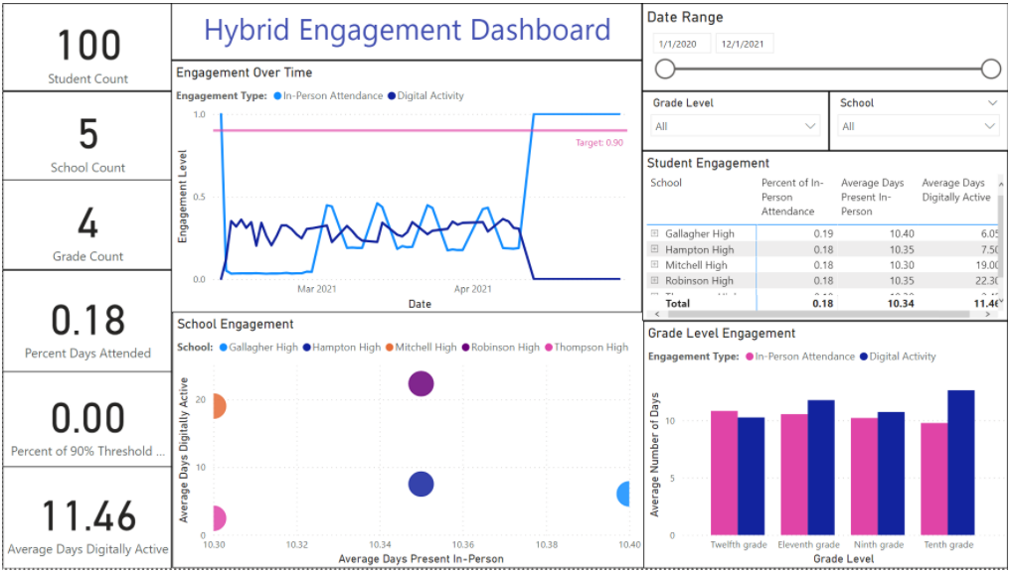
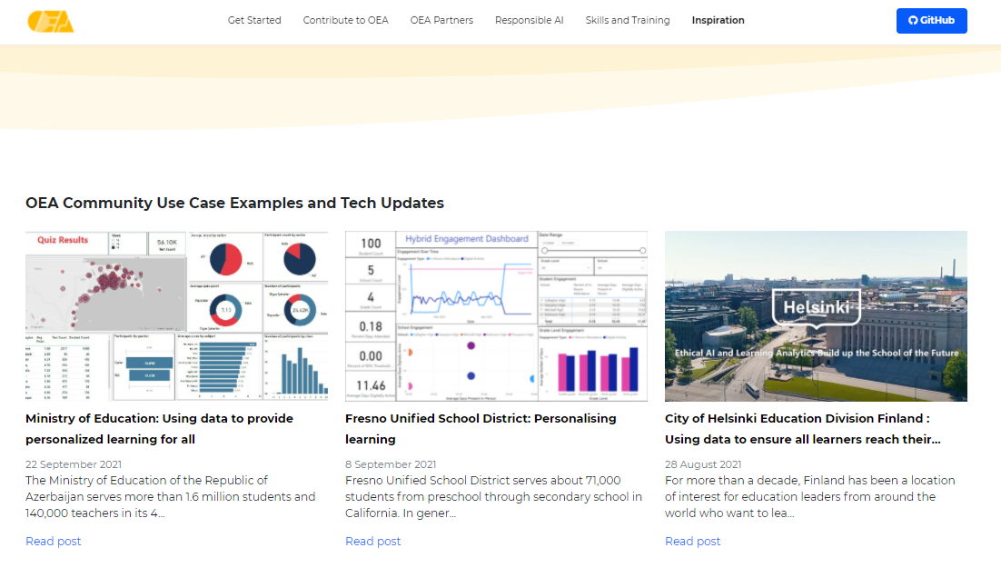
COMMUNITY OF EDUCATION SYSTEMS DEVELOPING SHARED USE CASES

Slide 13
DATA STANDARDS
RESPONSIBLE DATA AND AI
COMMON EDUCATION USE CASES
MODERN DATA TOOLS AND EDUCATION DATA SOURCES
GLOBAL OPEN-SOURCE COMMUNITY
SOLVING EDUCATION’S
BIG CHALLENGES TOGETHER

Slide 14
openeducationanalytics.org

